Slide 1

Intelligent Ayurvedic Medicine System for Arthritis
AyuAIra
22_23-J-73

Slide 2
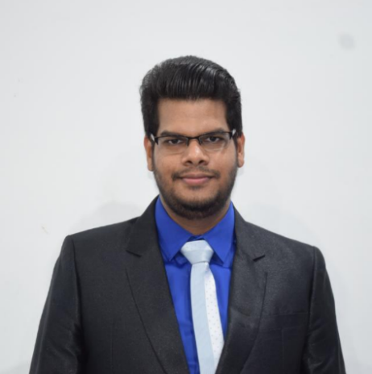
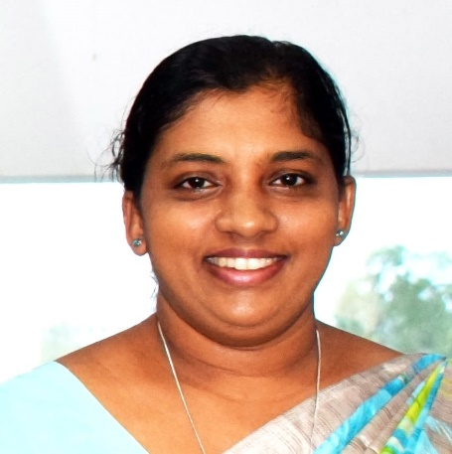
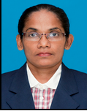
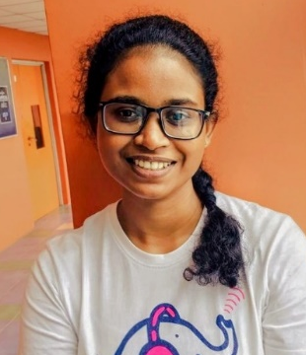
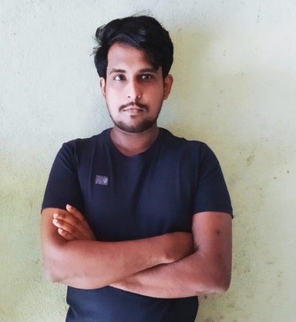
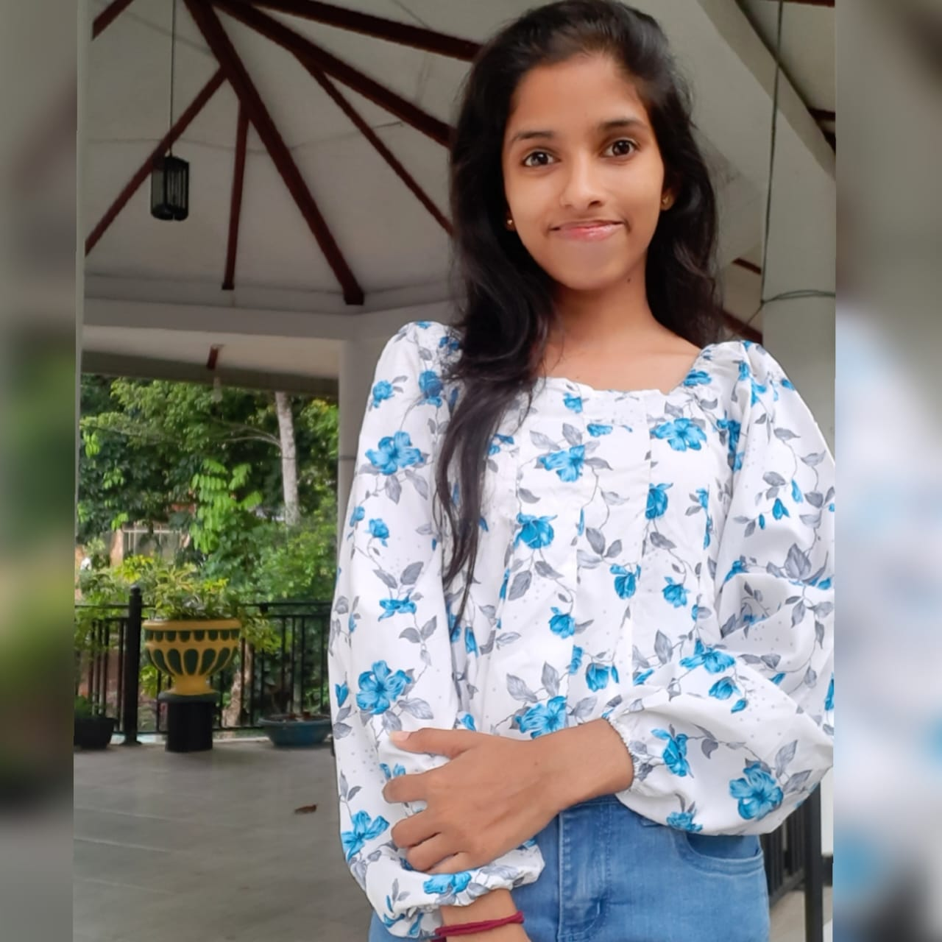
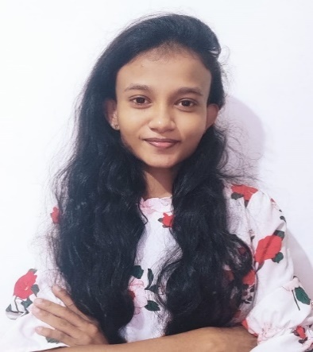
Team Members
External Supervisor
Dr.K.G.C.Dissanayake
Senior Lecturer
Gampaha Wickramarachchi Ayurveda Institute
Supervisor
Mr Ravi Supunya
Co-Supervisor
Ms Suriyaa Kumari
Hewapathirana L.L
IT19025322
Mallawaarachchi T.S
IT19955582
Samaranayaka S.W
IT19955414
Jayangika D.H.K.C
IT19146270

Slide 3
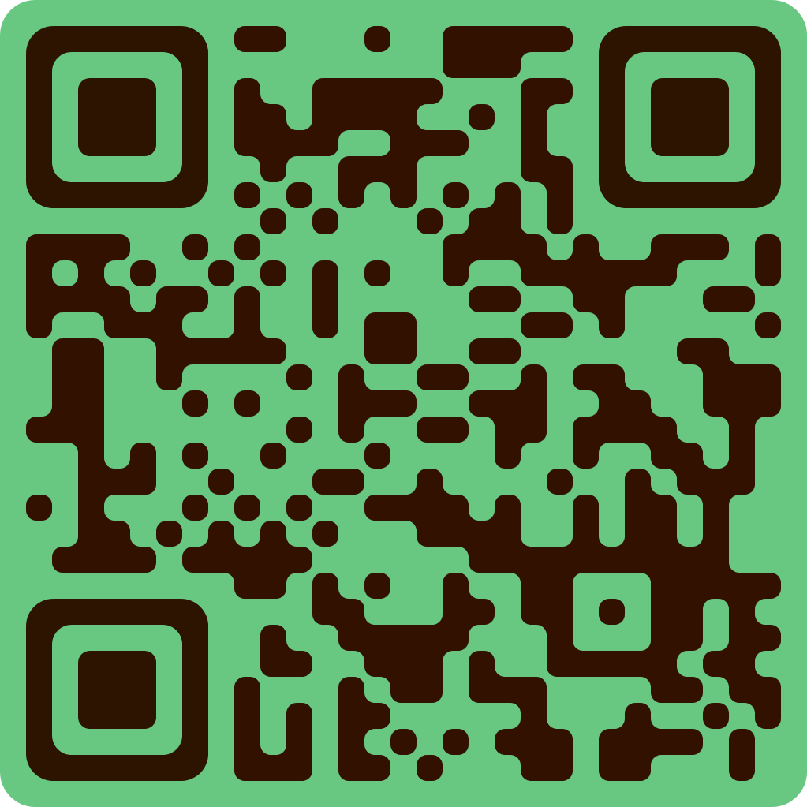
QR Scan of our Application (AyuAIra)

Slide 4
Introduction
The aim of this research is to develop an intelligent Ayurvedic medicine system for the early detection and effective management of arthritis.
The proposed system consists of four components,
X-Ray Image Analysis
Blood Report Monitoring
Ayurvedic Treatment Recommendation
Continuous Monitoring and Feedback.
The proposed system integrates advanced technology with traditional knowledge of Ayurvedic machine to provide a comprehensive solution for the early detection and effective management of arthritis.

Slide 5

Research Problem
How the Advanced technology and Ayurvedic medicine can be combined to provide a comprehensive solution for early detection and effective management of arthritis?

Slide 6

Main Objective
The aim of this research is to develop an intelligent Ayurvedic medicine system for the early detection and effective management of arthritis.

Slide 7
Sub Objective

Slide 8
Overall System Diagram

Slide 9

X-Ray Image Analysis
Hewapathirana L.L | IT19025322
B.Sc. (Hons) Degree in Information Technology Specialization in Information Technology

Slide 10
Introduction
Arthritis is a common ailment that affects millions of people worldwide, and Ayurvedic medicine has been used for centuries to treat this condition. However, accurately diagnosing and assessing the severity of arthritis can be challenging, especially when relying on human analysis of X-ray images.
Machine learning algorithms can help automate the analysis of X-ray images to accurately detect signs of arthritis and assess its severity in accordance with Ayurvedic principles.
This technology has the potential to revolutionize arthritis diagnosis and treatment, improving patient outcomes and quality of life.
IT19025322 | Hewapathirana L.L | Project ID : 22_23-J-73

Slide 11
Research Question
How can X-Ray images be analyzed using machine learning algorithms to accurately detect signs of arthritis and assess its severity?
IT19025322 | Hewapathirana L.L | Project ID : 22_23-J-73

Slide 12
Main and Sub Objective
Main Objective
To analyze X-Ray images to detect signs of arthritis and assess the severity of the condition.
Sub Objective
Identify relevant X-Ray Images datasets
To analyze X-Ray images to detect signs of arthritis
Assess the severity of arthritis based on the detected signs
IT19025322 | Hewapathirana L.L | Project ID : 22_23-J-73

Slide 13


System Diagram
Methodology
Tools and Technology
03. Requirements
IT19025322 | Hewapathirana L.L | Project ID : 22_23-J-73

Slide 14
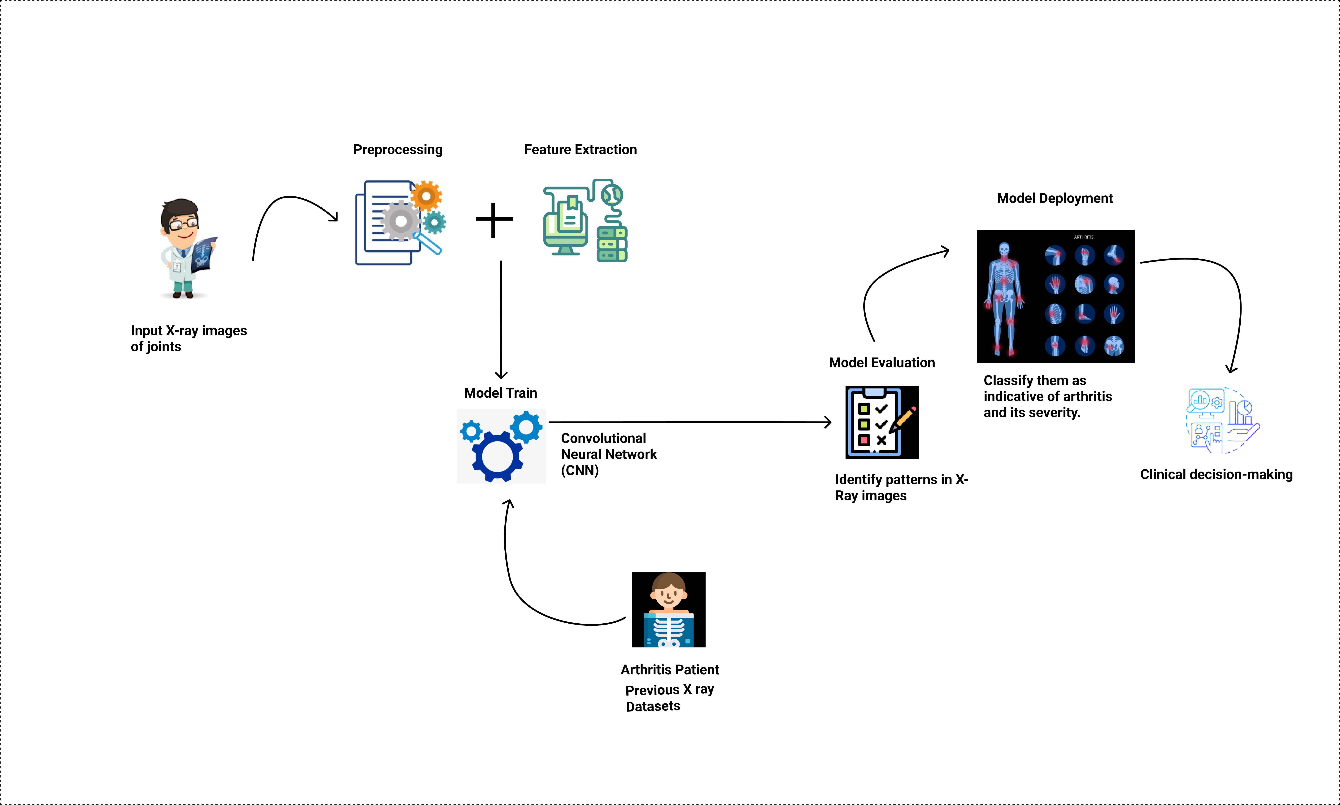
System Diagram
IT19025322 | Hewapathirana L.L | Project ID : 22_23-J-73

Slide 15


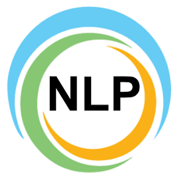

Tools and Technologies
Technologies
Techniques
Node JS
AWS
Google Collabs
React Native
Visual Studio IDE
Firebase,
Heroku
Data Preparation
Data Preprocessing
Segmentation
Feature Extraction
K-Nearest Neighbors (KNN)
IT19025322 | Hewapathirana L.L | Project ID : 22_23-J-73

Slide 16
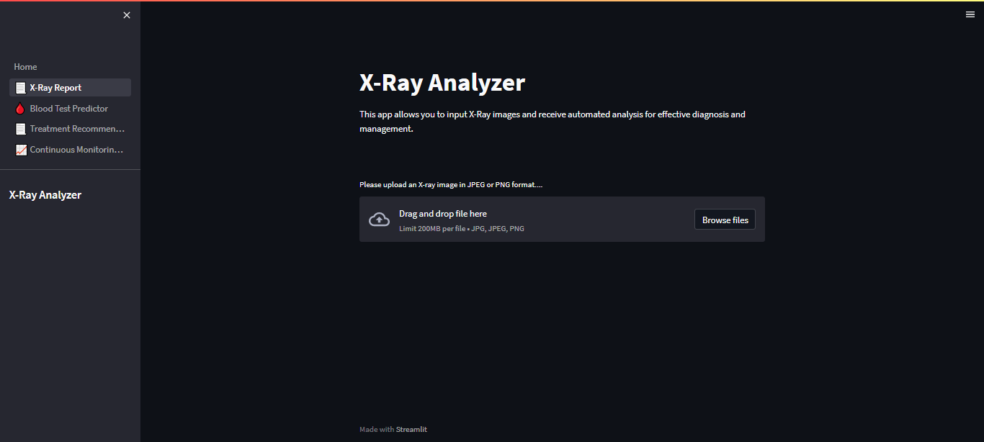
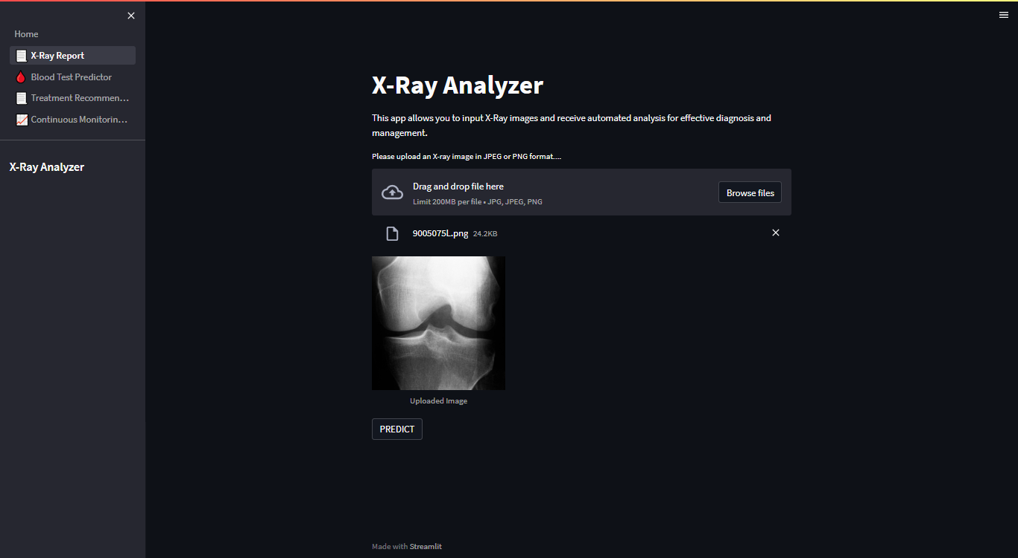
Completion of the project
IT19025322 | Hewapathirana L.L | Project ID : 22_23-J-73

Slide 17
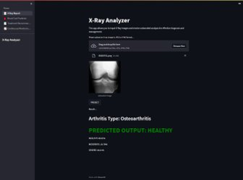
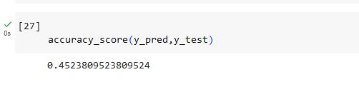
Completion of the project
K-Nearest Neighbors (Selected Algorithm)
IT19025322 | Hewapathirana L.L | Project ID : 22_23-J-73

Slide 18
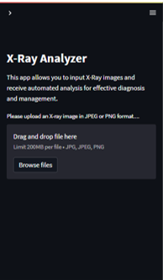
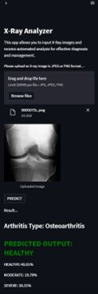
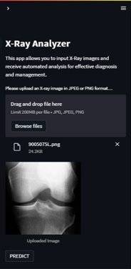
Completion of the project
IT19025322 | Hewapathirana L.L | Project ID : 22_23-J-73

Slide 19

Blood Report Monitoring
Mallawaarachchi | IT19955582
B.Sc. (Hons) Degree in Information Technology Specialization in Information Technology

Slide 20
Introduction
Arthritis is a disease that affects the joints, causing inflammation and pain. It can be difficult to predict how the disease will progress over time, which makes it challenging for doctors to develop effective treatment plans
Blood tests are essential in monitoring the progression of arthritis and evaluating the effectiveness of treatments.
Manual analysis of blood test results can be time-consuming, error-prone, and may not provide real-time insights into disease progression for doctors .
The application of deep learning algorithms, automate the analysis of blood test results and provide accurate predictions about disease progression and treatment efficacy.
Aims to highlight the potential of using deep learning algorithms to analyze blood test results for the diagnosis, monitoring, and treatment of arthritis.
IT19955582 | Mallawaarachchi T.S | Project ID : 22_23-J-73

Slide 21
Research Problem
How can blood test results be analyzed using deep learning algorithms to track the progression of arthritis and evaluate the effectiveness of treatments?
IT19955582 | Mallawaarachchi T.S | Project ID : 22_23-J-73

Slide 22
Main and Sub Objectives
Main Objective
To monitor blood test results over time to track the progression of arthritis and the effectiveness of treatments.
Sub Objectives
Identify relevant blood test parameters
Evaluate the effectiveness of treatments
Validate test results with an Ayurvedic traditional approach
IT19955582 | Mallawaarachchi T.S | Project ID : 22_23-J-73

Slide 23
Methodology
A recurrent neural network (RNN) was suggested to be developed to analyze time-series data of blood test results and predict the progression of arthritis.
As an alternative, a novel methodology that utilizes a Long Short-Term Memory (LSTM) network could be considered.
LSTM networks are particularly well suited for analyzing time-series data and making predictions about future trends.
01.System Diagram
03. Requirements
IT19955582 | Mallawaarachchi T.S | Project ID : 22_23-J-73

Slide 24
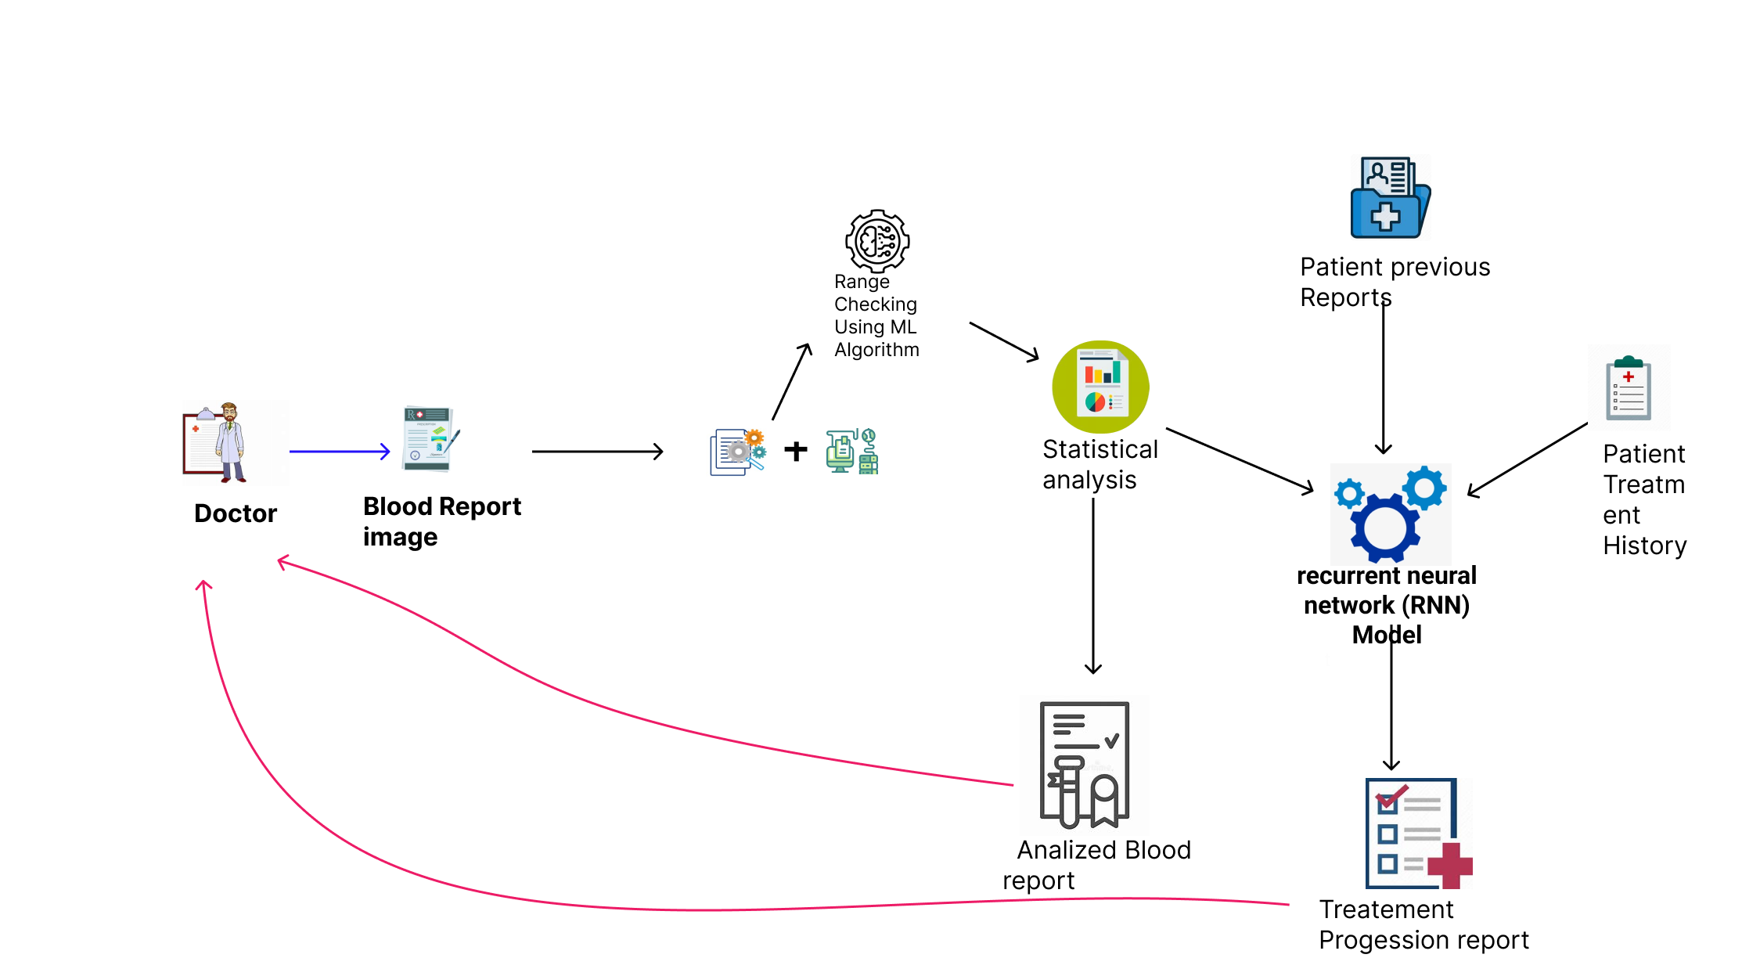
System Diagram
IT19955582 | Mallawaarachchi T.S | Project ID : 22_23-J-73

Slide 25
Tools and Technologies
Technologies
Techniques
Node JS
AWS
Google Collabs
React Native
Visual Studio IDE
Firebase
Data Preparation
Feature Extraction
Natural Language Processing (NLP)
Data Preprocessing
IT19955582 | Mallawaarachchi T.S | Project ID : 22_23-J-73

Slide 26
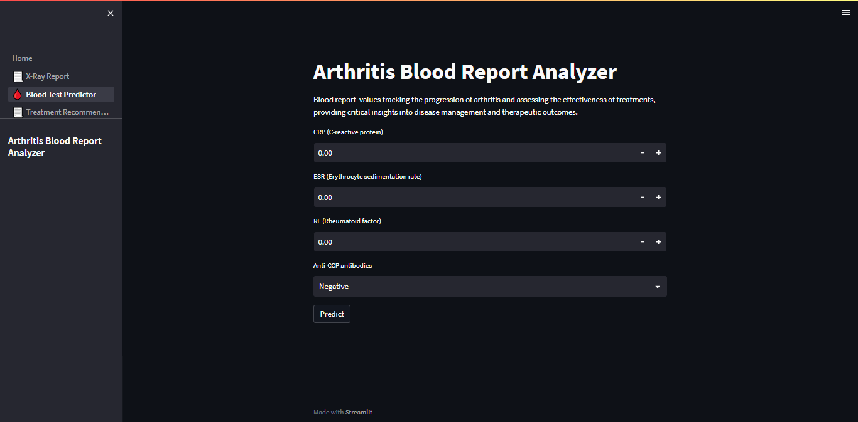
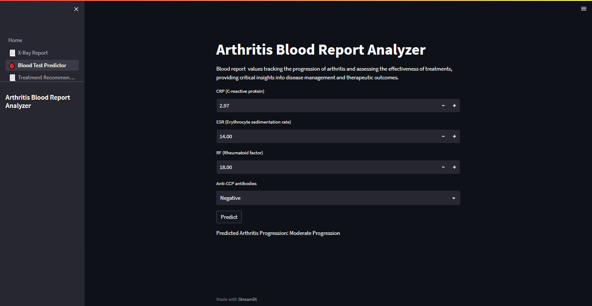
Completion of the project
IT19955582 | Mallawaarachchi T.S | Project ID : 22_23-J-73

Slide 27
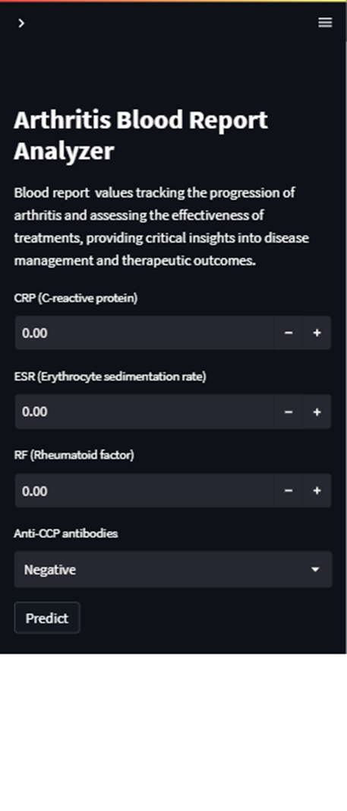
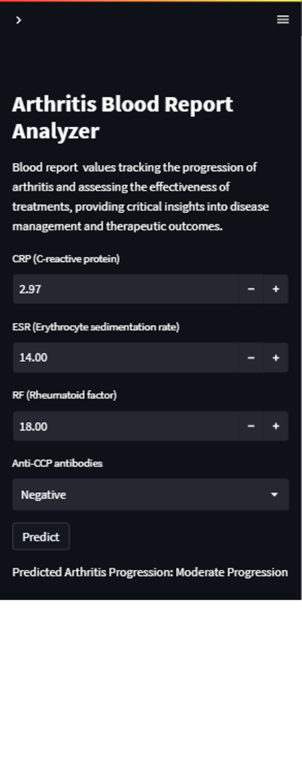
Completion of the project
IT19955582 | Mallawaarachchi T.S | Project ID : 22_23-J-73

Slide 28
Ayurvedic Treatment
Recommendation
Samaranayaka S.W | IT19955414
B.Sc. (Hons) Degree in Information Technology Specialization in Information Technology

Slide 29
Introduction
Arthritis affects millions of individuals worldwide and requires personalized treatment approaches for optimal outcomes.
The traditional knowledge of Ayurvedic medicine is combined with advanced technology to provide personalized treatment suggestions based on factors like age, sex, symptoms, and overall health for arthritis patients.
By integrating machine learning algorithms, such as the decision tree algorithm, we can enhance treatment efficacy and minimize side effects.
The Ayurvedic Treatment Recommendation system aims to improve the quality of life for arthritis patients by offering individualized and holistic care.
IT19955414 | Samaranayaka S.W | Project ID : 22_23-J-73

Slide 30
Research Problem
How can traditional knowledge of Ayurvedic medicine be integrated with advanced technology to provide personalized treatment recommendations for arthritis patients?
IT19955454 | Samaranayaka S.W | Project ID : 22_23-J-73

Slide 31
Main and Sub Objectives
Main Objective
To provide personalized treatment recommendations based on the principles of Ayurvedic medicine, taking into account factors such as the patient's age, sex, symptoms, and overall health.
Sub Objectives
Gather data on arthritis and its various treatments
Analyze the patient's data and the Ayurvedic medicine database
Provides personalized treatment recommendations for the patient
IT19955414 | Samaranayaka S.W | Project ID : 22_23-J-73

Slide 32
Methodology
System Diagram
01.System Diagram
Tools and Technology
03. Requirements
IT19955414 | Samaranayaka S.W | Project ID : 22_23-J-73

Slide 33
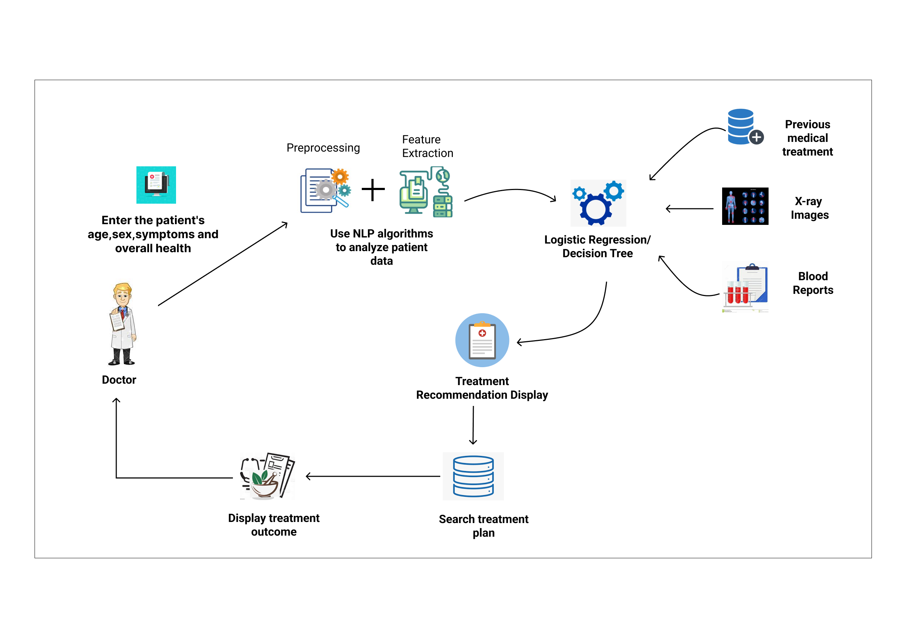
System Diagram
IT19955414 | Samaranayaka S.W | Project ID : 22_23-J-73

Slide 34
Tools and Technologies
Technologies
Techniques
Node JS
python
Google Collabs
Streamlite
Visual Studio IDE
Anaconda/
Heroku
Data Preparation
Feature Extraction
Decision Tree Algorithm
IT19955414 | Samaranayaka S.W | Project ID : 22_23-J-73

Slide 35
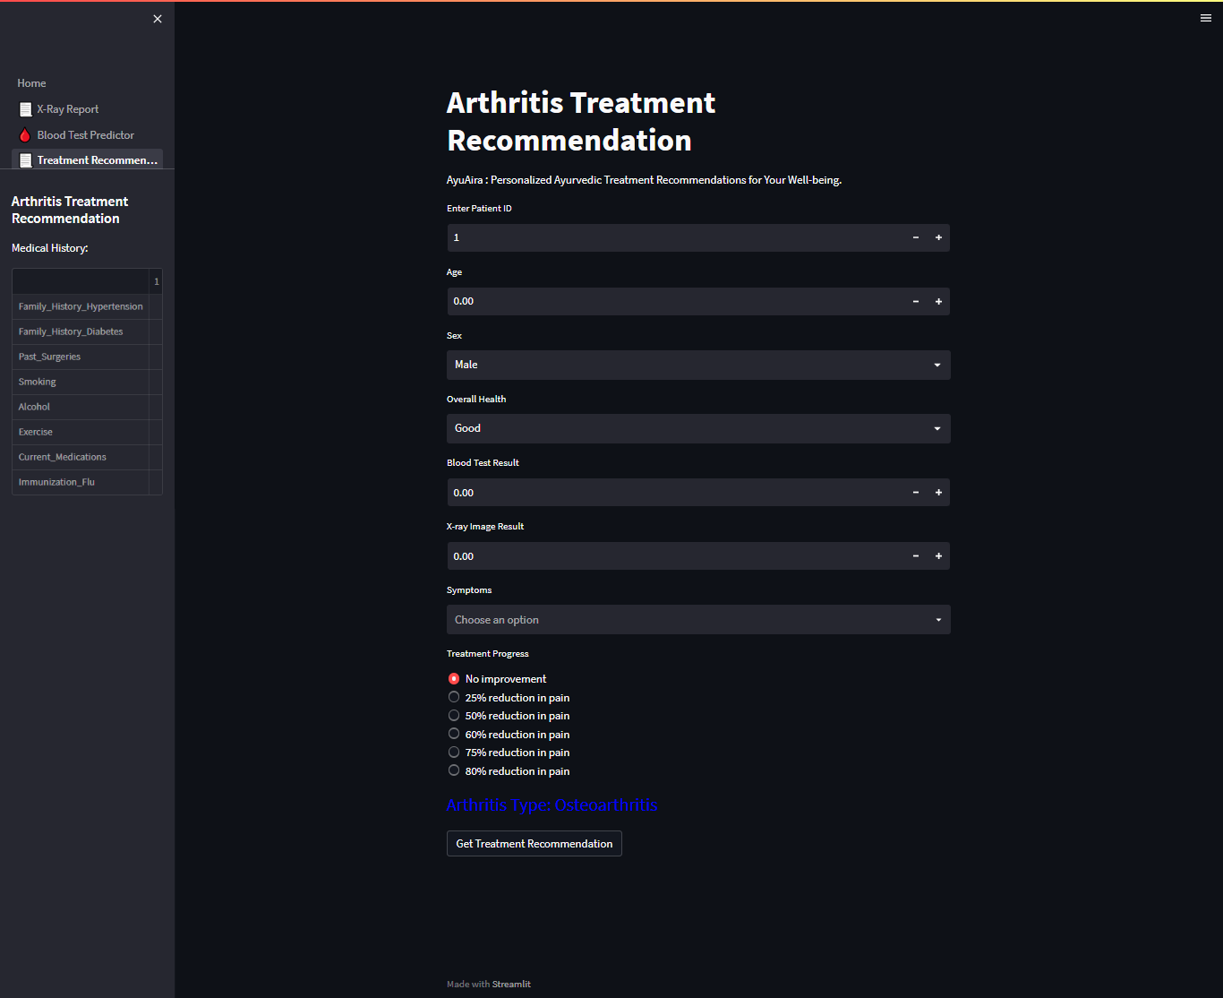
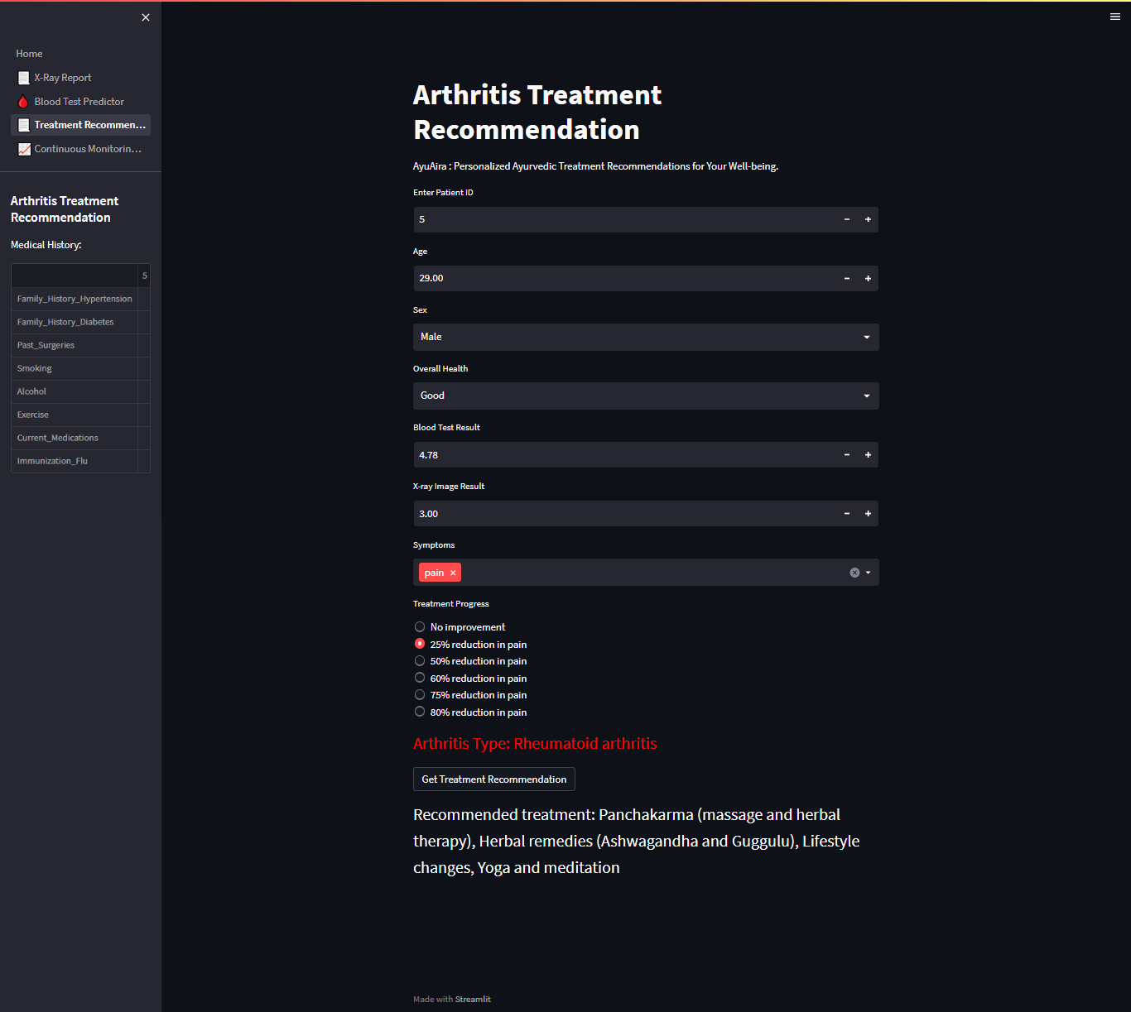
Completion of the project
UIs and Frontend :
IT19955414 | Samaranayaka S.W | Project ID : 22_23-J-73

Slide 36
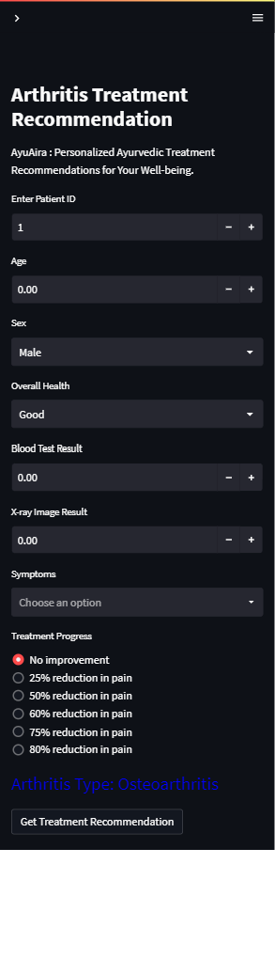
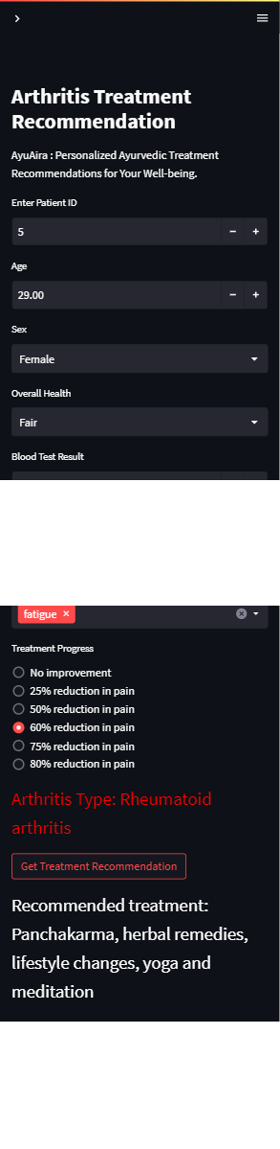
Completion of the project
UIs and Frontend :
IT19955414 | Samaranayaka S.W | Project ID : 22_23-J-73

Slide 37
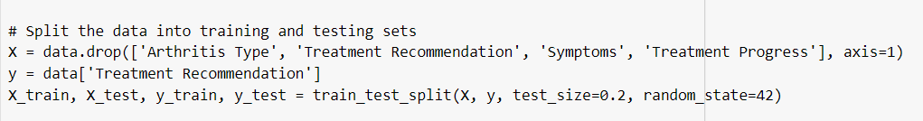
Completion of the project
Treatment Recommending model Develop :
Considering both training and validation accuracies DecisionTreeClassifer selected as the Ml Algorithm to training the recommending model.
Data Split :
Train 80%
Test 20%
IT19955414 | Samaranayaka S.W | Project ID : 22_23-J-73

Slide 38

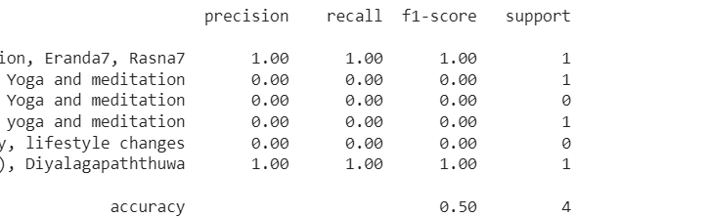
Completion of the project
Evidences of model Accuracy:
IT19955414 | Samaranayaka S.W | Project ID : 22_23-J-73

Slide 39

Continuous Monitoring and
Feedback.
Jayangika D.H.K.C | IT19146270
B.Sc. (Hons) Degree in Information Technology Specialization in Information Technology

Slide 40
Introduction
Arthritis is a common and chronic disease affecting millions of people worldwide, and it can cause significant pain, inflammation, and joint damage.
Ayurveda, a traditional Indian system of medicine, focuses on holistic healing and personalized treatment approaches.
Traditional Ayurvedic medicine is a personalized approach to treatment, which requires monitoring the patient's symptoms, treatment progress, and overall health.
Leveraging the power of machine learning and the XGBoost algorithm, we aim to develop a predictive model that provides real-time feedback to the treating doctor, leading to more accurate and personalized treatments.
IT19146270 | Jayangika D.H.K.C | Project ID : 22_23-J-73

Slide 41
Research Question
How can machine learning algorithms be used to continuously monitor the patient's symptoms, treatment progress, and overall health, and provide real-time feedback?
IT19146270 | Jayangika D.H.K.C | Project ID : 22_23-J-73

Slide 42
Objective
Specific Objective
To continuously monitor the patient's symptoms, treatment progress, and overall health, and provide feedback to the treating doctor.
Sub Objective
Analyze the x-ray report ,blood report and treatment progress
Monitor the arthritis patient's symptoms, treatment progress, and overall health
Providing Real time Feedback
IT19146270 | Jayangika D.H.K.C | Project ID : 22_23-J-73

Slide 43
Methodology
System Diagram
01.System Diagram
Tools and Technology
03. Requirements
IT19146270 | Jayangika D.H.K.C | Project ID : 22_23-J-73

Slide 44
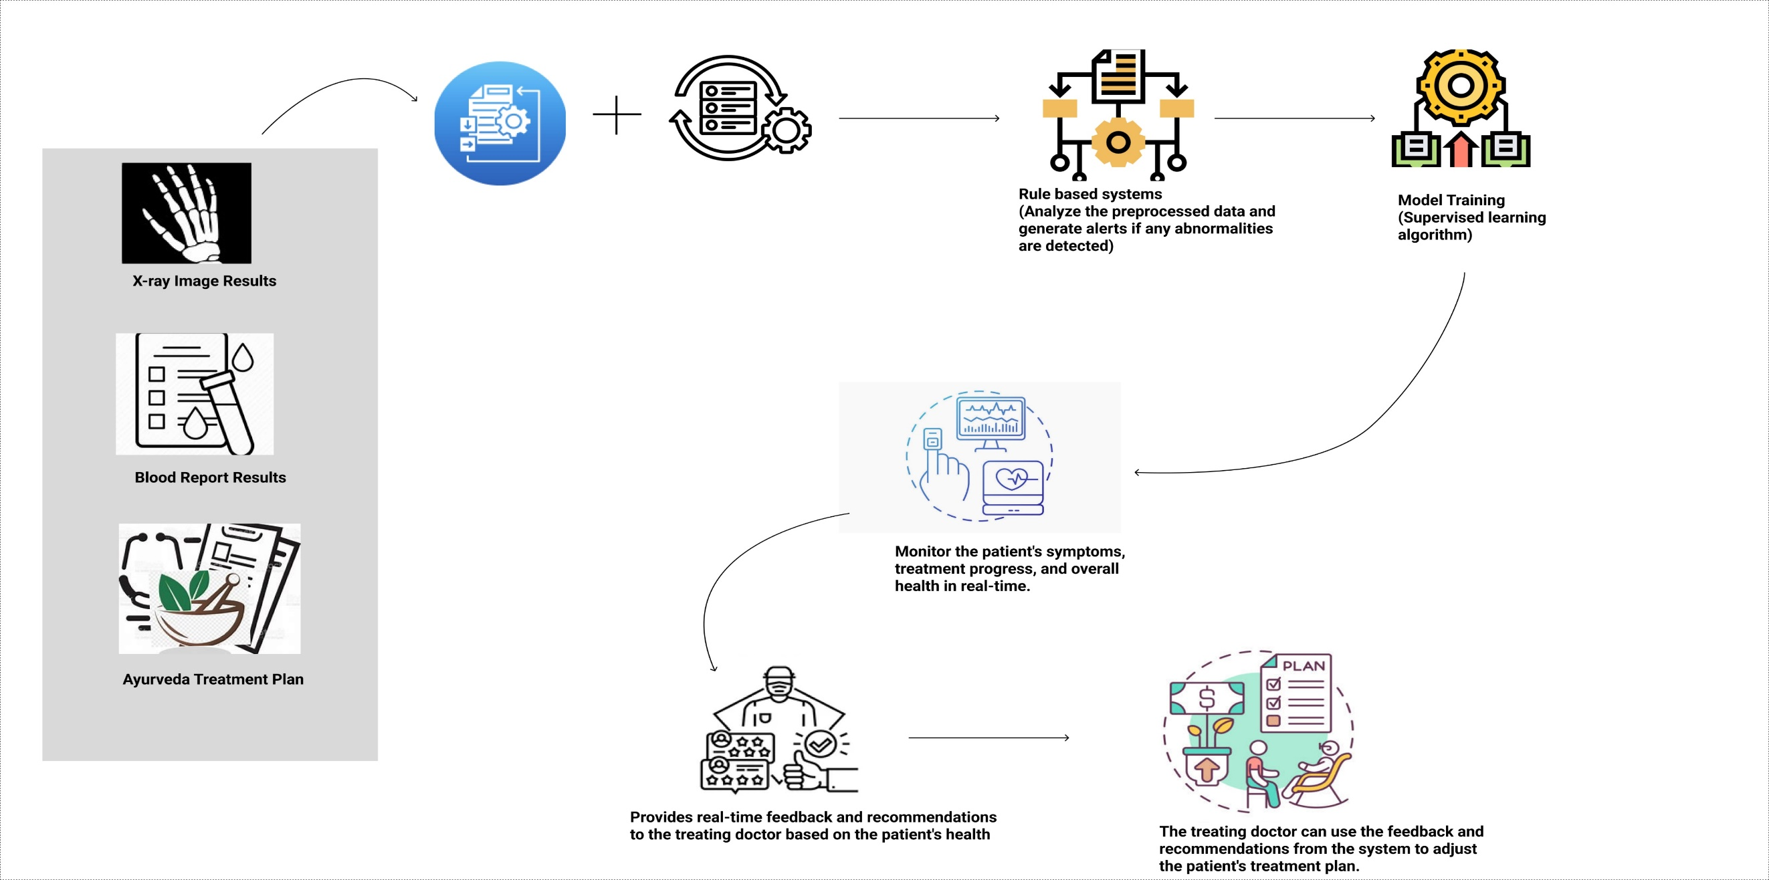
System Diagram
IT19146270 | Jayangika D.H.K.C | Project ID : 22_23-J-73

Slide 45
Tools and Technologies
Technologies
Techniques
Node JS
Python
AWS
Google Collabs
Anaconda
Heroku
Data Preprocessing
Feature Extraction
XGBOOST
IT19146270 | Jayangika D.H.K.C | Project ID : 22_23-J-73

Slide 46
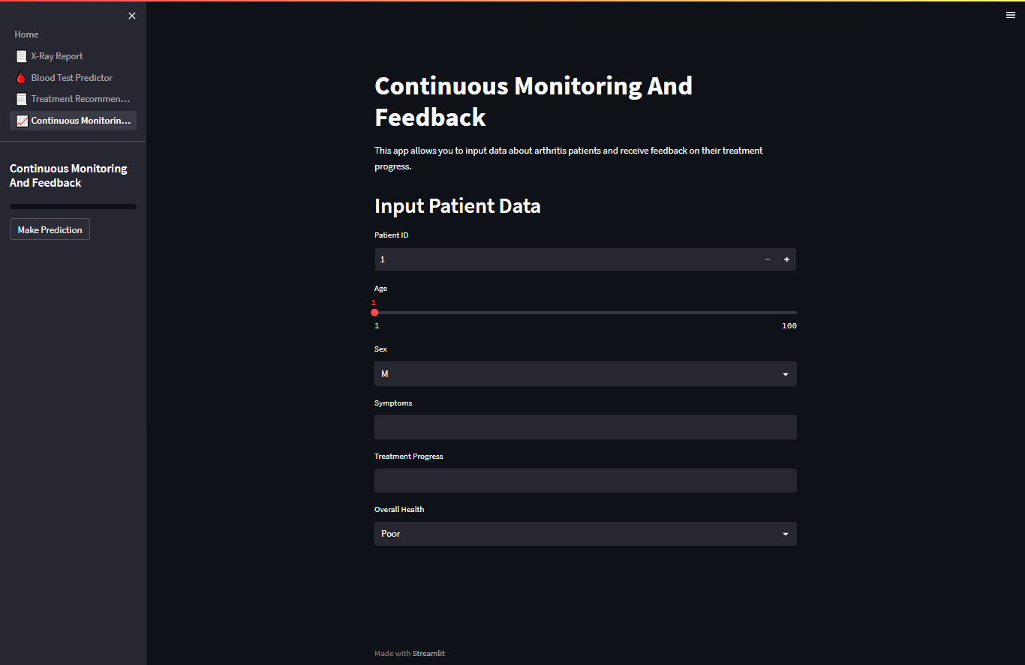
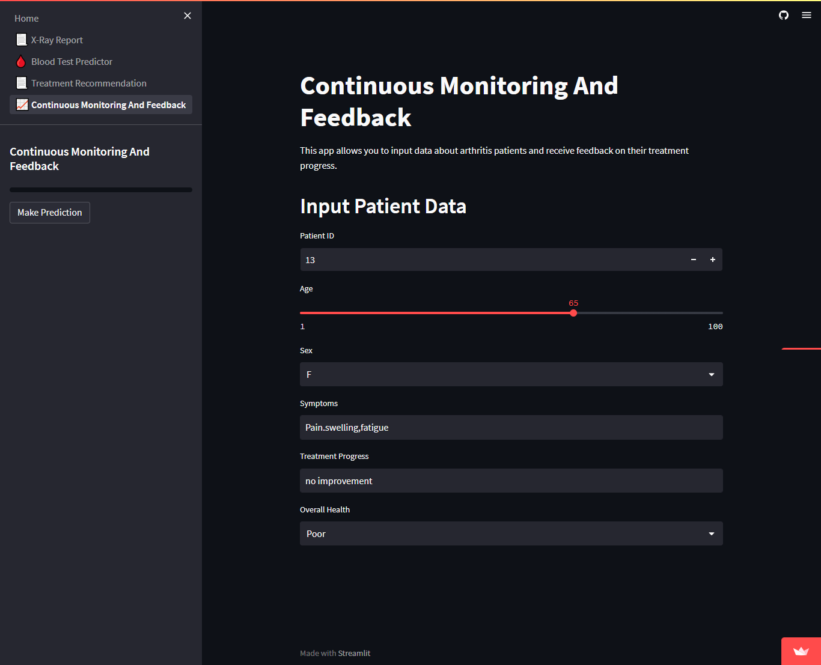
Completion of the project
IT19146270 | Jayangika D.H.K.C | Project ID : 22_23-J-73

Slide 47
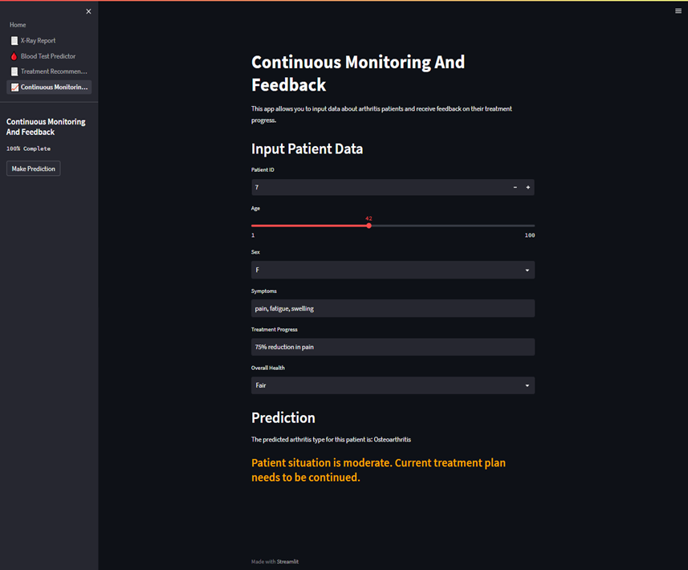
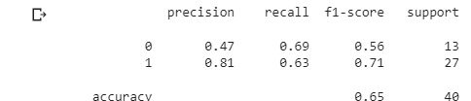
Completion of the project
Selected Algorithm XG Boost Algorithm
IT19146270 | Jayangika D.H.K.C | Project ID : 22_23-J-73

Slide 48
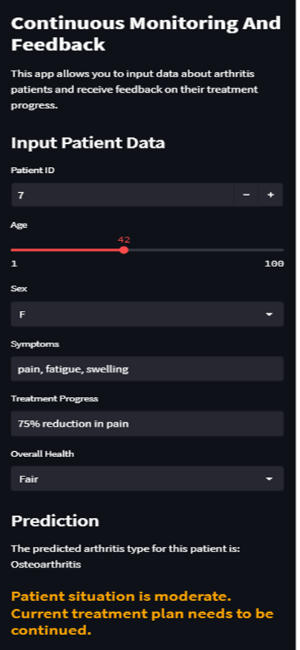
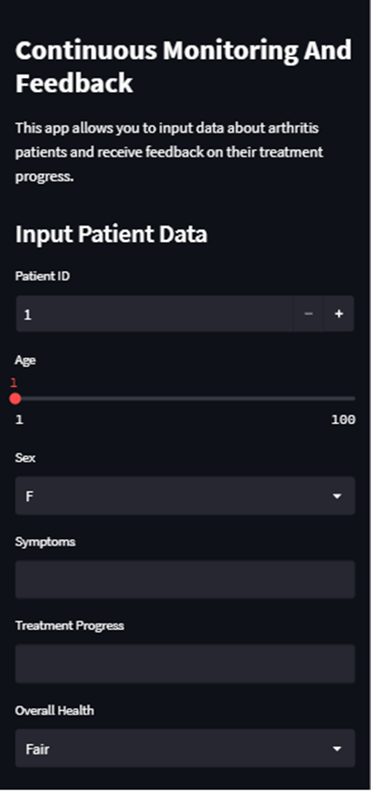
Completion of the project
IT19146270 | Jayangika D.H.K.C | Project ID : 22_23-J-73

Slide 49

Risk Mitigation

Slide 50
Risk Mitigation
Completed the work according to a time plan.
Upload the code into GitLab.
Stored the data in Google drive as a backup.
Execute work according to the MS Planner.

Slide 51
Commercialization

Slide 52
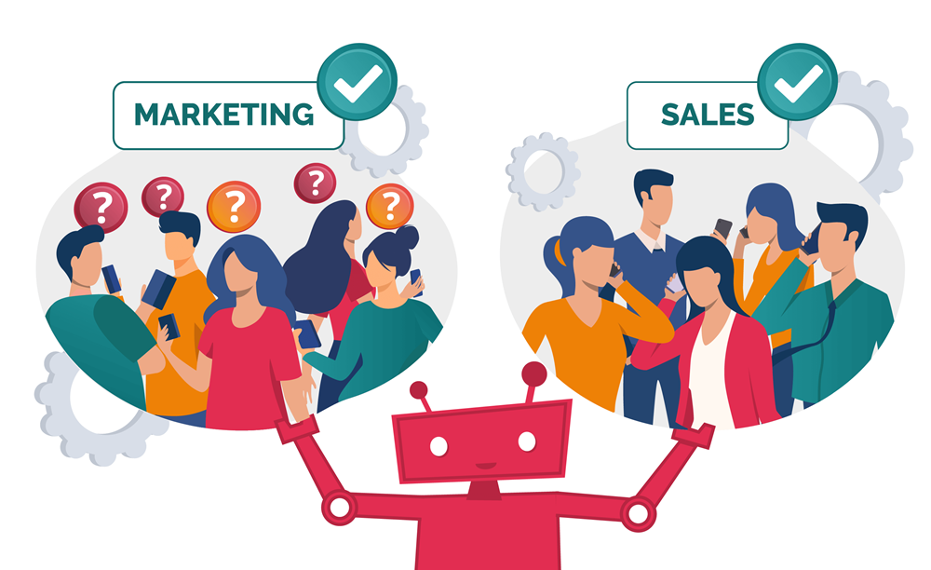
Marketing Strategies
Targeted Audience:
Ayurvedic Doctors
Promoting Methods:
Social media campaign
Industry Conferences

Slide 53
Marketing Strategies
Business Plan:
Give a one-month trial for ayurvedic doctors.
Get feedback from the ayurvedic doctors and make necessary changes.
Marketing Plan:
Create a prototype and give it to the doctors.
Create a plan for social media and email marketing.

Slide 54
THANK YOU!

